Slide 1
Bootstrability program
Solving (planar) N=4 SYM using
integrability + crossing symmetry
Ongoing work with Michelangelo, Andrea, Julius and Nika
EXACTC

Slide 2
Is the spectrum itself sufficient to obtain non-spectral observables? in combination with conformal symmetry

Slide 3
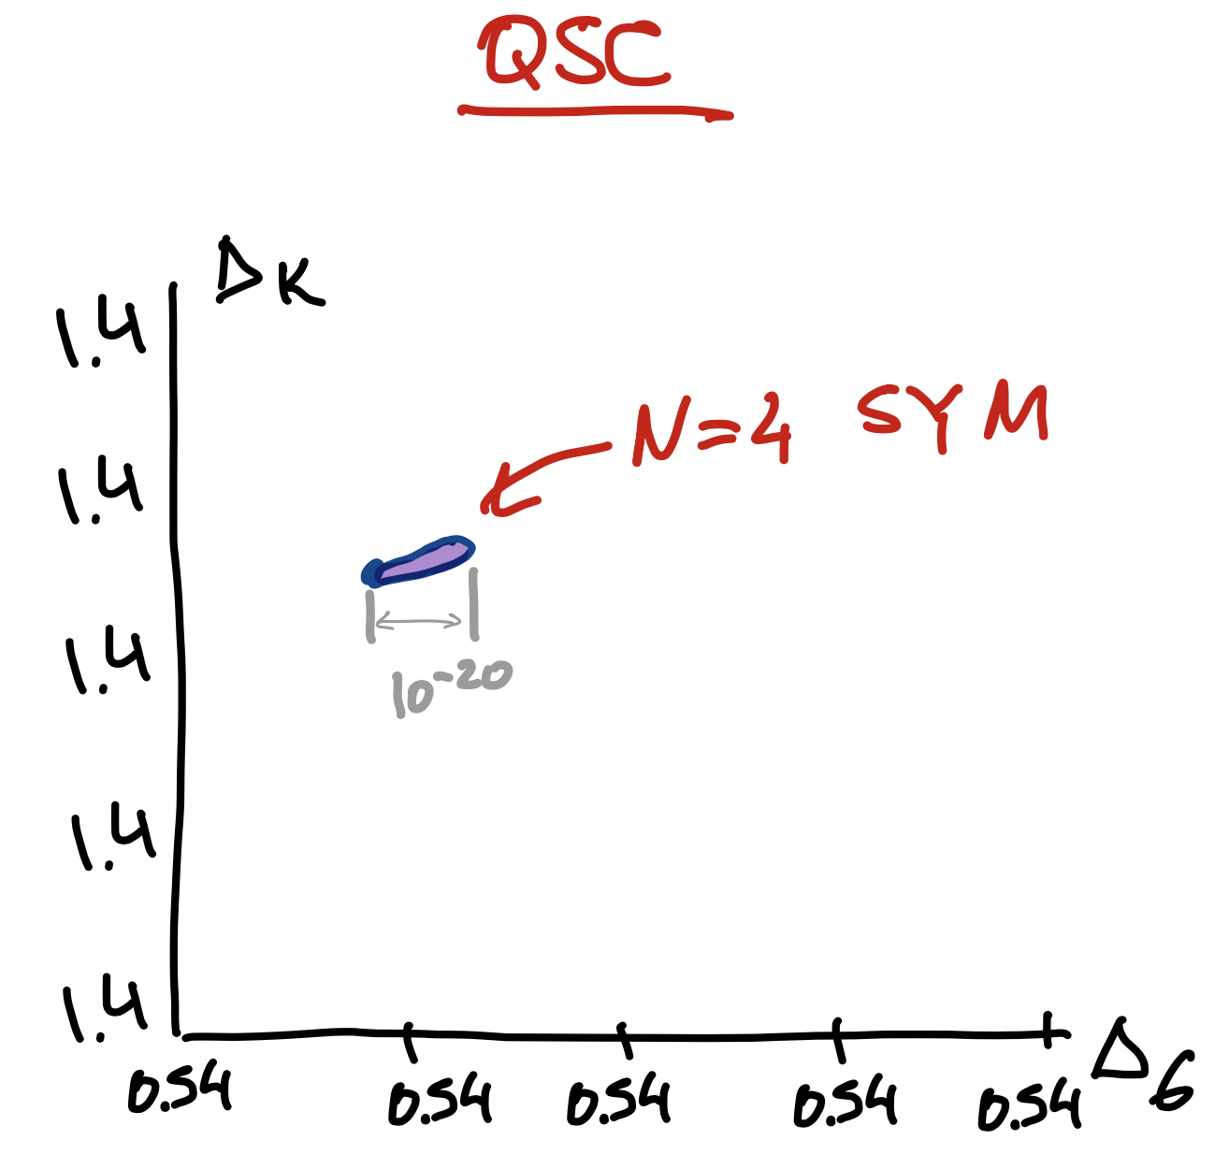
Conformal bootstrap vs Integrability
D. Simmons-Duffin `15
D. Poland, S. Rychkov, and A. Vichi, `14

Slide 4
What we know about the spectrum
NG, V.Kazakov, S.Leurent, D.Volin `13
QSC is a system of functional relations constrained by special analyticity properties.
NG, F.Levkovick-Maslyuk, G.Sizov `15
Highly efficient numerical and analytic methods to solve QSC were developed
Currently we have 100th of states with up to 60 digits accuracy

Slide 5
Bootstrability
A.Cavaglià, NG, J.Julius, M.Preti, N.Sokolova `21-`22

Slide 6
Concrete set-up
N. Drukker `12
D. Correa, J. Maldacena, and A. Sever `12
N. Gromov and F. Levkovich-Maslyuk `15
Know the spectrum of the defect CFT
All correlators are O(N^0)
No “double traces” problem
Price to pay: less symmetry, same number of operators
Very far from saturating vanilla bootstrap bounds
P. Liendo, C. Meneghelli, and V. Mitev `18
P. Ferrero and C. Meneghelli `21
P. Liendo and C. Meneghelli `16
L. Bianchi, G. Bliard, V. Forini, L. Griguolo, and D. Seminara `20

Slide 7
1/2 BPS Wilson line
$$t$$
$$W=\text{TrP}e^{∫dt\left(iA_{t}+Φ_{||}\right)}$$
[Maldacena, ’98]
16 preserved supercharges
Bosonic subgroup
$$OSp(2,2|4)$$
$$SO(1,2)×SO(3)×SO(5)$$
Line and circle vevs are related by a famous anomaly, but they are finite.
$$\left\langle W_{line}\right\rangle =1. ⟨W_{circle}⟩=\frac{2}{\sqrt{λ}}I_{1}(\sqrt{λ})$$
[Erickson, Semenoff, Zarembo, ’00]
[Drukker, Gross, ‘01]
Superconformal defect where local operators reorganise in representations of the preserved superalgebra.
Protected 1/2 BPS multiplets
Non-protected long operators
$O_{Δ_{1}}=Φ_{||}+…$,
$$\left\{O_{Δ_{2}},O_{Δ_{3}}\right\}=\text{Span}\left\{Φ_{||}^{2},∑_{i}^{5}Φ_{⊥}^{i}Φ_{⊥}^{i}\right\}+…$$
$ℬ_{1}=\left\{Φ_{⊥}^{i},i≤5;…\right\}$ ,
$ℬ_{2}=\left\{Φ_{⊥}^{(i}Φ_{⊥}^{j)},i,j≤5;…\right\}$,

Slide 8
Correlators on the defect and OPE
$$O_{1}$$
$$O_{2}$$
$$t$$
$$O_{n}$$
$$⟨⟨O_{1}(t_{1})O_{2}(t_{2})…O_{n}(t_{n})⟩⟩$$
$$≡\text{Tr}\left[\text{P}e^{∫_{−∞}^{t_{1}}dt\left(iA_{t}+Φ_{||}\right)}O_{1}(t_{1})e^{∫_{t_{1}}^{t_{2}}dt\left(iA_{t}+Φ_{||}\right)}O_{2}(t_{2})…O_{n}(t_{n})e^{∫_{t_{n}}^{+∞}dt\left(iA_{t}+Φ_{||}\right)}\right]$$
= Infinitesimal bumps in the Wilson line
Insertions in adjoint of $SU(N_{c})$,
e.g. $O=Φ_{⊥}^{i}$ ,
$O=Φ_{||}$,
$O=(Φ^{b}F_{μν}Φ^{c}D_{ρ}Ψ…)$, …
[Drukker,Kawamoto ’06]
These observables satisfy 1D CFT axioms as the OPE decomposition.
For instance considering two $ℬ_{1}$ multiplets we have
$$ℬ_{1}×ℬ_{1}=ℐ+ℬ_{2}+\underset{Δ}{∑}ℒ_{0,[0,0]}^{Δ}$$

Slide 9
Simplest 4-point function
The simplest operator in $ℬ_{1}$:
$$Φ_{⊥}^{1}≡Φ_{⊥}$$
$$⟨⟨Φ_{⊥}(x_{1})Φ_{⊥}(x_{2})Φ_{⊥}(x_{3})Φ_{⊥}(x_{4})⟩⟩=\frac{1}{x_{12}^{2}}\frac{1}{x_{34}^{2}}𝒜(χ)$$
$$χ=\frac{x_{12}x_{34}}{x_{13}x_{24}} x_{ij}=x_{i}−x_{j}$$
With cross ratio and
Crossing equation:
$$x_{1}$$
$$x_{4}$$
$$=$$
$$=$$
$$x_{1}$$
$$x_{2}$$
$$x_{3}$$
$$x_{4}$$
$$x_{4}$$
$$x_{1}$$
$$x_{2}$$
$$x_{3}$$
$$x_{2}$$
$$x_{3}$$
$$\frac{1}{x_{12}^{2}x_{34}^{2}}𝒜(χ)=\frac{1}{x_{14}^{2}x_{23}^{2}}𝒜(1−χ)$$

Slide 10
Constraints of superconformal symmetry
Studying the related topological sector
$$𝔽=1+C_{BPS}^{2}=\frac{3W_{circle}W_{circle}^{′′}}{(W_{circle}^{′})^{2}}$$
Known differential operator
reproduced by integrability
[Cavaglià, Gromov, Julius, MP ’22]
$$𝒜(χ)=𝔽χ^{2}+𝒟_{χ}∘f(χ)$$
[Liendo Meneghelli Mitev ‘17]
Operator Product Expansion
$$f(χ)=f_{I}(χ)+C_{BPS}^{2}(λ)f_{ℬ_{2}}(χ)+∑_{Δ}C_{1,1,Δ}^{2}f_{Δ}(χ)$$
Superconformal blocks
$$f_{I}(χ)=χ$$
$$f_{ℬ_{2}}(χ)=χ\left(1− _{2}F_{1}(1,2,4;χ)\right)$$
singlets of $SO(5)×SO(3)$,
nontrivial dimensions
$$f_{Δ}(χ)=\frac{1}{1−Δ}\left[χ^{Δ+1} _{2}F_{1}(Δ+1,Δ+2,2(Δ+2);χ)\right]$$

Slide 11
Constraints of conformal symmetry
The reduced correlator $f(χ)$ still obeys to the crossing equation
$$𝒢(χ)≡(1−χ)^{2}f(χ)+χ^{2}f(1−χ)=0$$
and rewriting it in terms of the OPE expansion we obtain
$$\underset{\text{explicit} \text{function}}{\underset{⏟}{𝒢_{I}(χ)+C_{BPS}^{2}(λ)𝒢_{ℬ_{2}}(χ)}}+∑_{Δ}C_{1,1,Δ}^{2}𝒢_{Δ}(χ)=0$$
$$≡𝒢_{1+ℬ_{2}}(λ,χ)$$
Existing results
[Liendo, Meneghelli, Mitev ’17]
Numerical bootstrap
Functional bootstrap at strong coupling
[Meneghelli Ferrero ’21]

Slide 12
Integrability for the spectrum

Slide 13
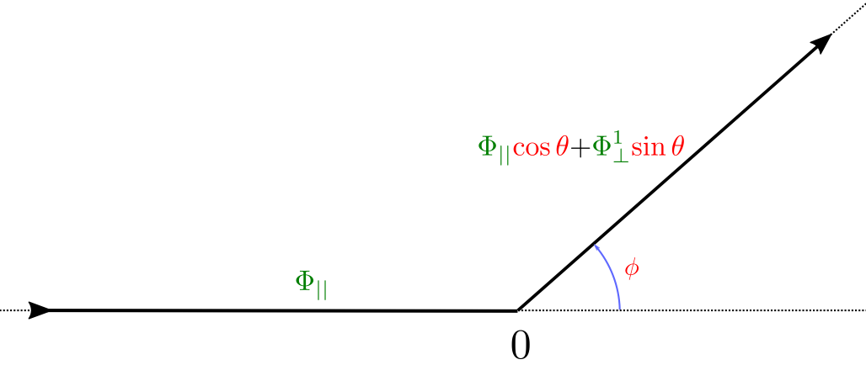
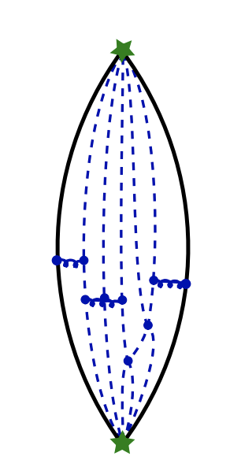
Integrability for the cusped Wilson line
$$O_{L}$$
$$O_{L}$$
Weak coupling
For “orthogonal” insertions: [Correa, Maldacena, Sever ’12] [Drukker ’12]
[Bonini, Griguolo, MP, Seminara ’15] (wrapping terms)
For “parallel” insertions: [Correa, Leoni, Luque ’18] (1-loop, one sector)
Non-perturbative
For “orthogonal” insertions: [Correa Maldacena Sever ’12] [Drukker ’12] (TBA)
[Gromov,Levkovich-Maslyuk’15] (QSC)
For “parallel” insertions: [Cavaglià, Gromov, Levkovich-Maslyuk ’15] (ladder)
[Grabner, Gromov, Julius ’20] (general $θ,φ$)

Slide 14
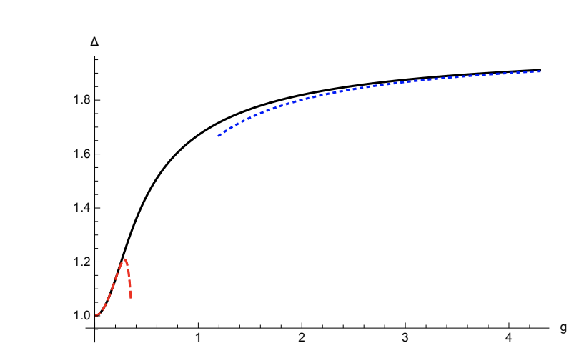
Integrability for the cusped Wilson line
$$O_{L}$$
$$O_{L}$$
Non-perturbative scaling dimension for $Φ_{||}$ (the simplest operator appearing in the long multiplet)
[Grabner,Gromov,Julius ’20]

Slide 15
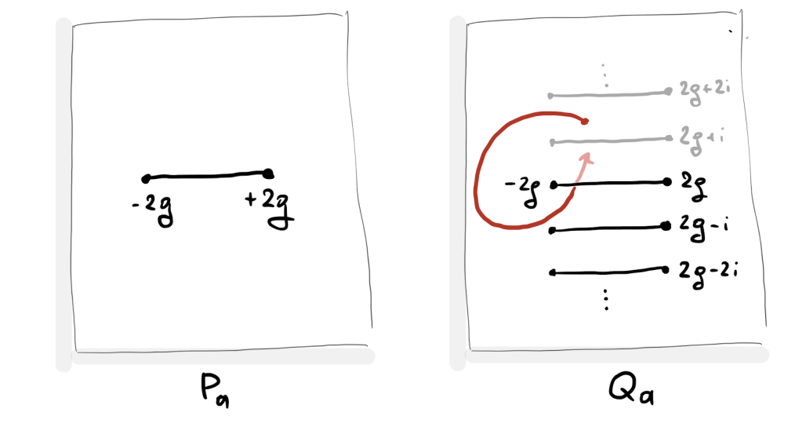
Crash course on QSC
Functional relations (algebra) + Analytic properties for Q-functions
QQ-relations
(reduction of PSU(2,2|4) system)
$$Q_{a|i}(u+\frac{i}{2})−Q_{a|i}(u−\frac{i}{2})=P_{a}(u)Q_{i}(u)$$
$$Q_{i}(u)=P^{a}(u)Q_{a|i}(u±\frac{i}{2}),$$
$$P_{a}(u)=Q^{i}(u)Q_{a|i}(u±\frac{i}{2}),$$
$$P^{a}(u)=χ^{ab}P_{b}(−u),Q^{i}(u)=χ^{ij}Q_{j}(−u)$$
$$(16π^{2}λ=g^{2})$$
Q-functions have cuts dictated by the ’t Hooft coupling

Slide 16
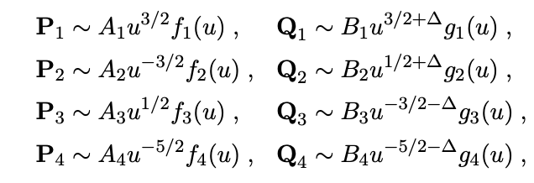
QSC for the straight line
parameters
$$g_{a}(u)≃1,u→∞$$
$$f_{a}(u)=∑_{n=0}^{∞}\frac{c_{a,n}}{x^{n}(u)}$$
With QQ-relations, we can get all Q-functions numerically in terms of $\left\{c_{a,n}\right\}$
Fix parameters numerically by imposing gluing across the cut (-2g, 2g)
[Julius, PhD Thesis]
[Cavaglià, Gromov, Julius, MP ’21]
Many solutions! = Many states!
Weak coupling solutions are needed to find good starting points

Slide 17
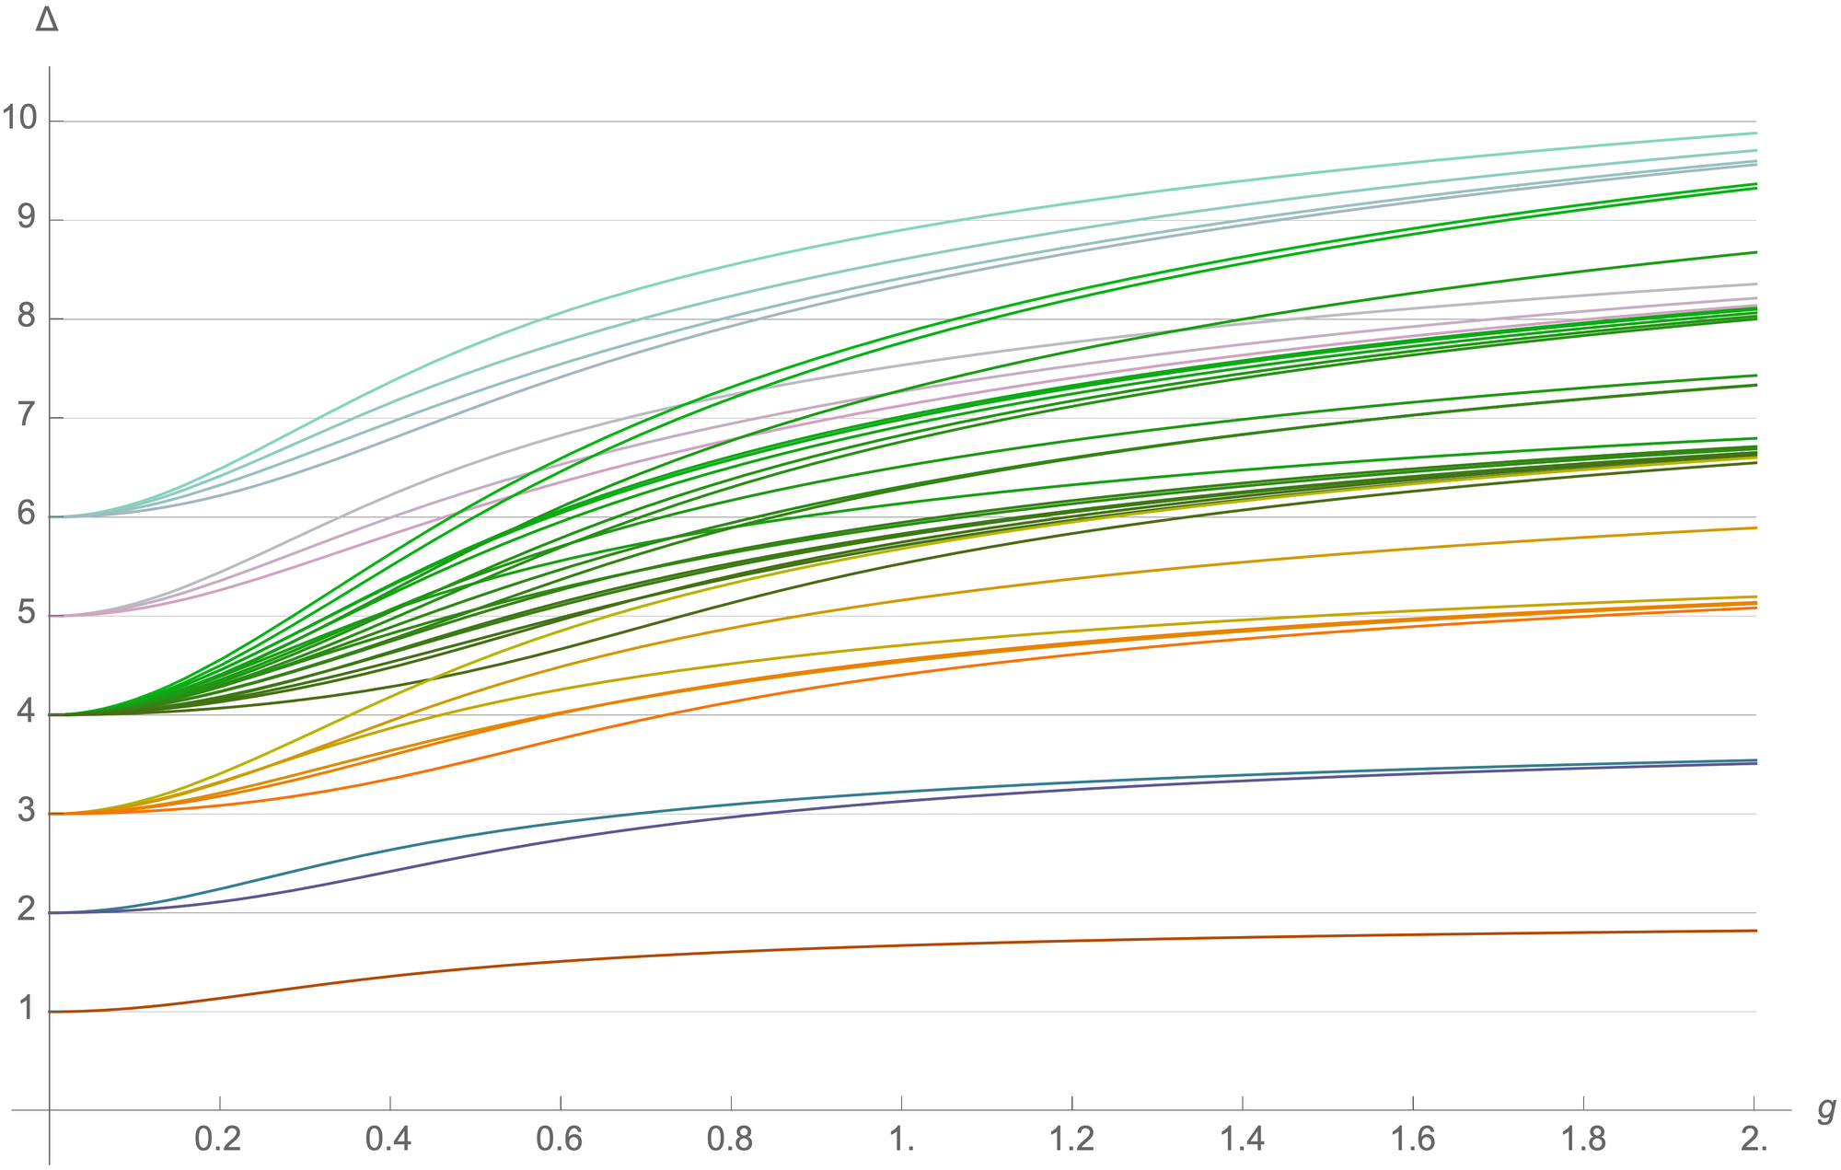
The spectrum
[Cavaglià, Gromov, Julius, MP ’21]
[Grabner,Gromov,Julius ’20]
complete
[Julius, PhD Thesis]
complete

Slide 18
Bootstrapping OPE coefficients

Slide 19
Bootstrability setup
The bootstrap equation obtained before is
$$𝒢_{1+ℬ_{2}}(λ,χ)+∑_{Δ_{n}}C_{1,1,Δ_{n}}^{2}𝒢_{Δ_{n}}(χ)=0$$
1D CFT is unitary $C_{1,1,Δ}^{2}≥0$
Now we have access to the spectrum!
General numerical bootstrap setup:
Given a linear functional $α$, impose how it acts on the crossing equation
Use inequalities to bound the allowed conformal data.
[El-Showk,Paulos,Poland,Rychkov,
Simmons-Duffin,Vichi ’12]
This can be done efficiently with Semi Definite Programming.
We use the powerful package SDPB
[Simmons-Duffin ’15]
Truncation is necessary, but the bounds are rigorous:
$α\left[f(χ)\right]∼∑_{l=0}^{N_{der}}α_{l}{f^{(2l)}(χ)|}_{χ=\frac{1}{2}}$ , bounds better and better for $N_{der}→∞$.

Slide 20
Bounds for the first OPE coefficient $C_{1,1,Δ_{1}}^{2}$
$$𝒢_{1+ℬ_{2}}(λ,χ)+C_{1,1,Δ_{1}}^{2}𝒢_{Δ_{1}}(χ)+∑_{n≥2}C_{1,1,Δ_{n}}^{2}𝒢_{Δ_{n}}(χ)=0$$
Using SDPB, find the functional such that
Lower bound
$α^{upper}[𝒢_{Δ_{1}}]=1$ ,
$α^{upper}[𝒢_{Δ}]≥0$ for $Δ≥Δ_{∗}≡Δ_{2}$
$α^{upper}[𝒢_{1+ℬ_{2}}]$ is maximal $≡−{\text{B}}_{upper}$
$α^{lower}[𝒢_{Δ_{1}}]=−1$ ,
$α^{lower}[𝒢_{Δ}]≥0$ for $Δ≥Δ_{∗}≡Δ_{2}$
$α^{lower}[𝒢_{1+ℬ_{2}}]$ is maximal $≡{\text{B}}_{lower}$
Upper bound
$$−{\text{B}}_{upper}+C_{1,1,Δ_{1}}^{2}+(≥0quantity)=0$$
$$+{\text{B}}_{lower}−C_{1,1,Δ_{1}}^{2}+(≥0quantity)=0$$
$${\text{B}}_{lower}≤C_{1,1,Δ_{1}}^{2}≤{\text{B}}_{upper}$$

Slide 21
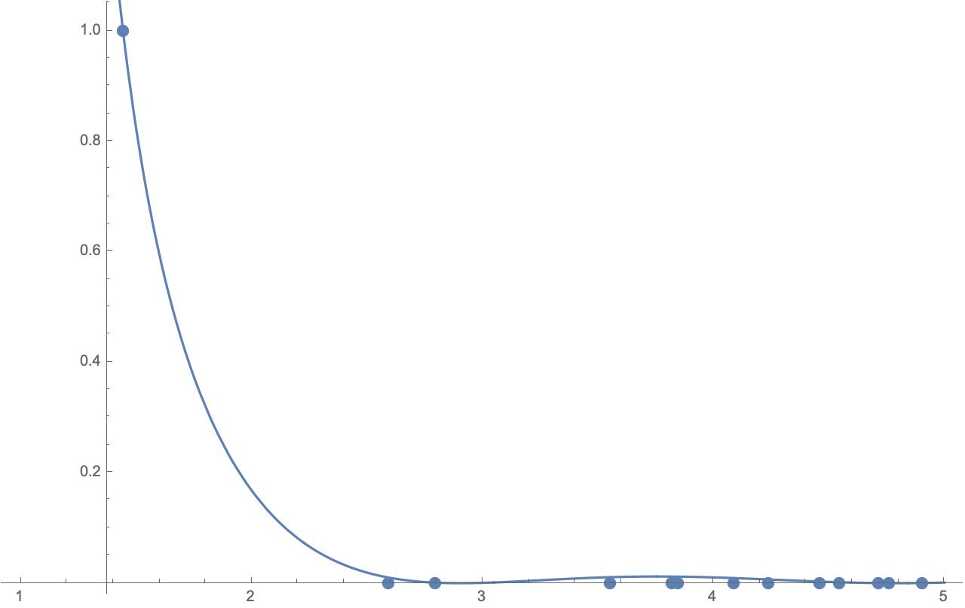
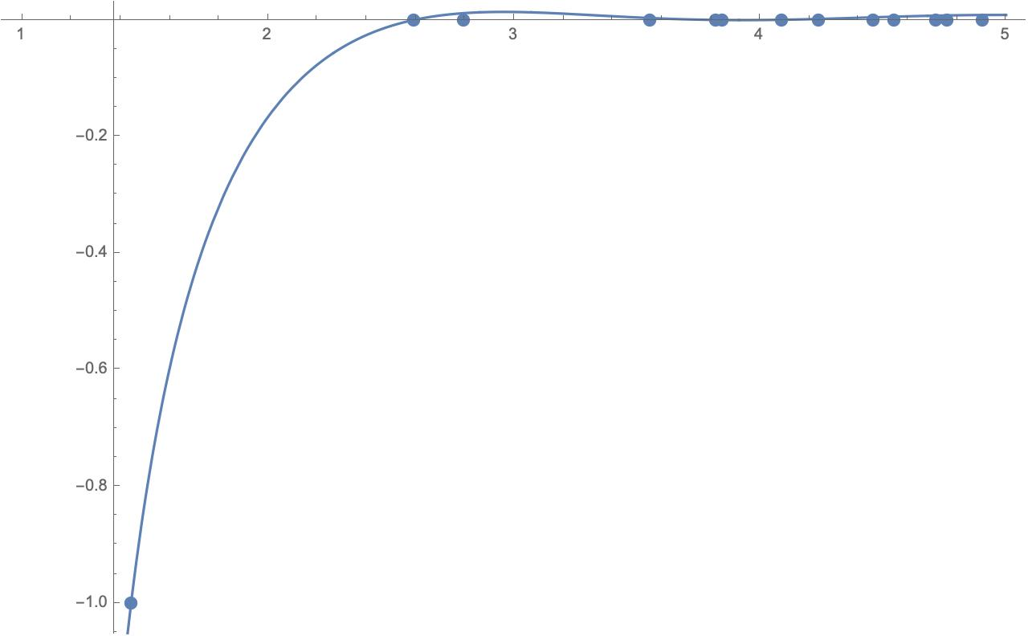
$$α^{upper}\left[𝒢_{Δ}\right]$$
The two functionals for coupling g=1/2, $N_{der}=20$
$$Δ$$
$$α^{lower}\left[𝒢_{Δ}\right]$$
$$Δ_{2}$$
$$Δ$$
$$Δ_{2}$$

Slide 22
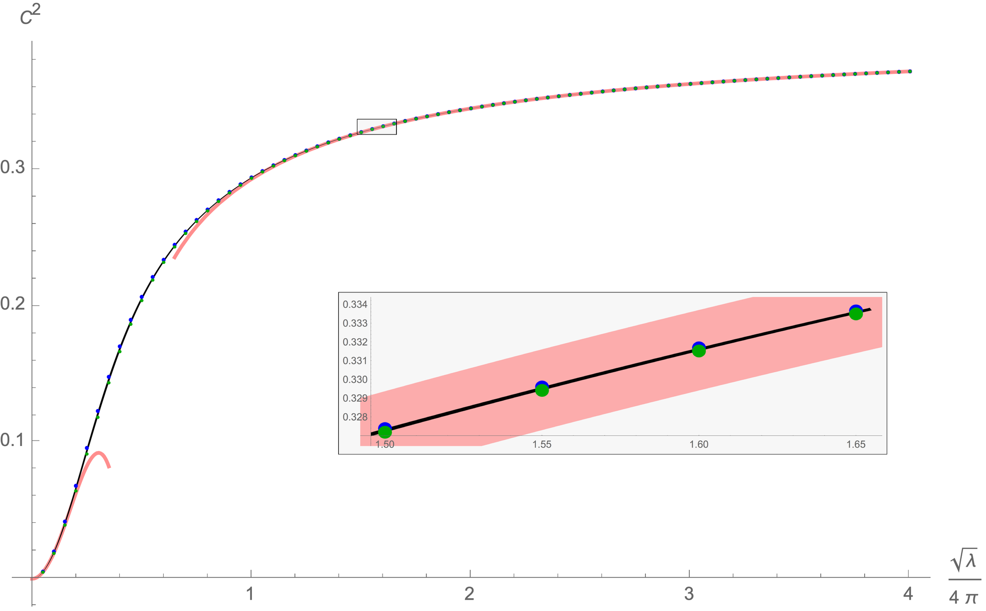
OPE coefficient $C_{1,1,Δ_{1}}^{2}$including only 2 states
[Cavaglià, Gromov, Julius, MP ’21]
Strong coupling
[Ferrero Meneghelli ’21]
Strong coupling
[Ferrero Meneghelli ’21]
Weak coupling
[Kiryu Komatsu’18] ; [Cavaglià, Gromov, Julius, MP ’22]
The error is computed measuring the thickness of the region, namely $1/2(C_{upper}^{2}−C_{lower}^{2})$
Strong coupling has higher precision (${10}^{−4}$) than weak coupling (${10}^{−2}$)

Slide 23
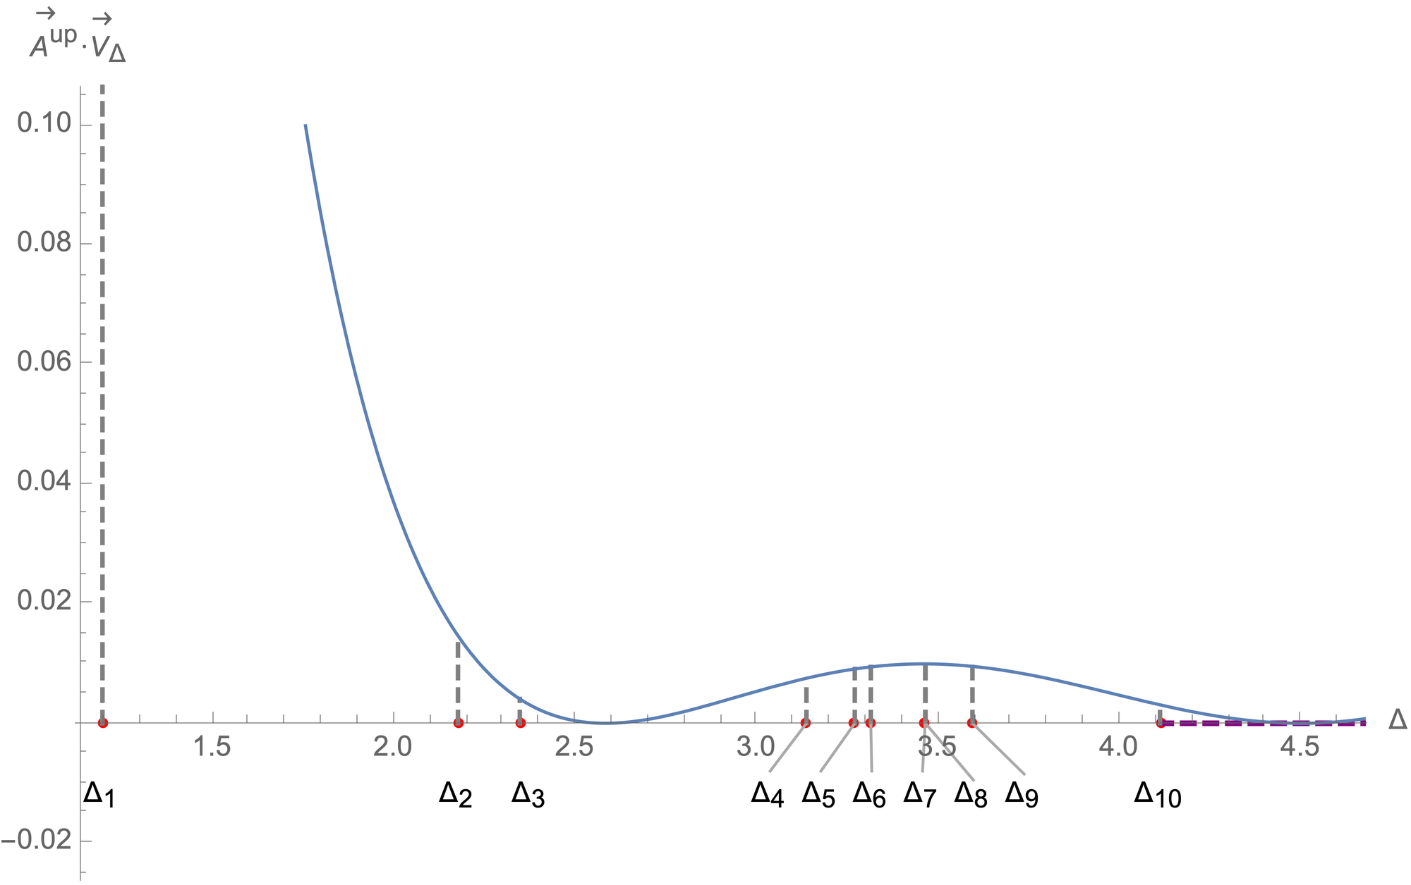
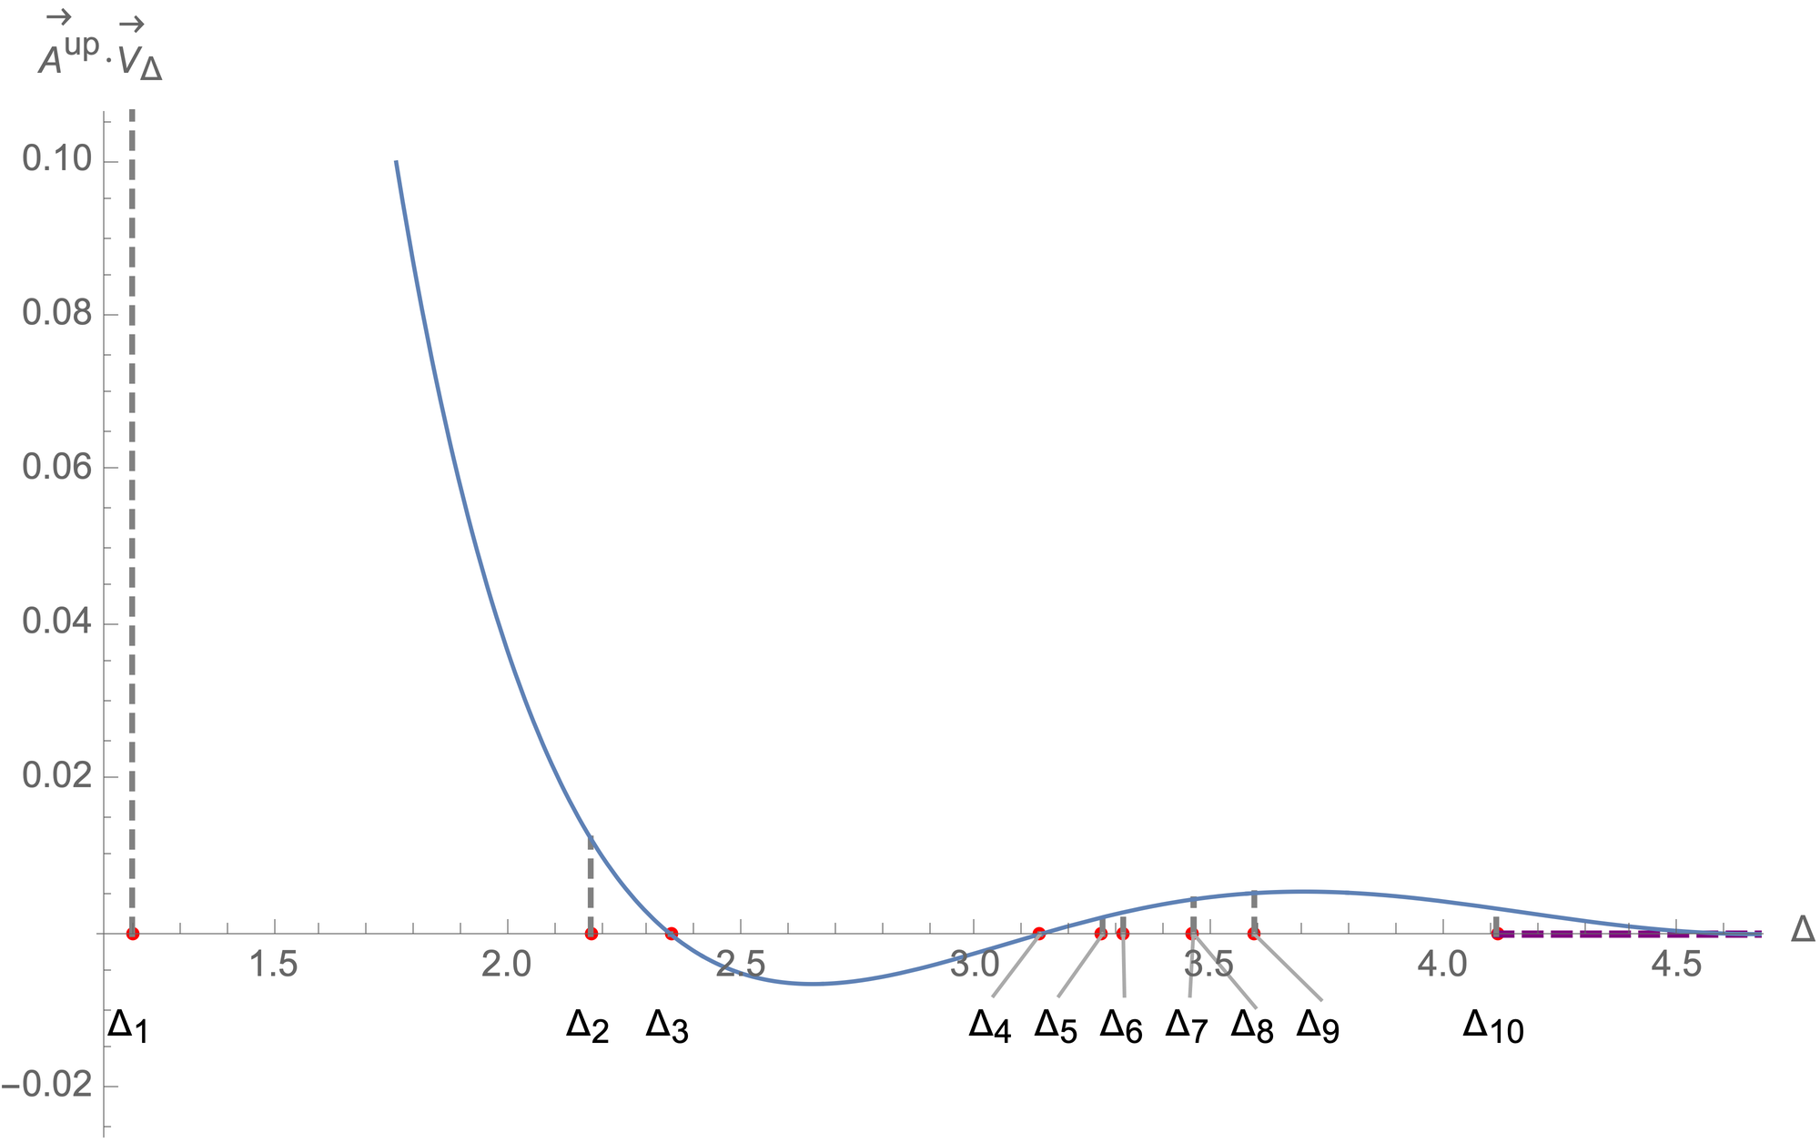
A natural generalisation
A new algorithm to include the knowledge of the first $n$ states to compute the structure constant $C_{1,1,Δ_{m}}^{2}$ with $m<n$.
[Cavaglià, Gromov, Julius, MP ’22]
$α^{upper}[𝒢_{Δ_{m}}]=1$ ,
$α^{upper}[𝒢_{Δ}]≥0$ for $Δ≥Δ_{∗}≡Δ_{n}$
$α^{upper}[𝒢_{Δ_{k}}]≥0$ for $kε\{1,...n−1\}$
$α^{upper}[𝒢_{1+ℬ_{2}}]$ is maximal $≡−{\text{B}}_{upper}$
$α^{lower}[𝒢_{Δ_{m}}]=−1$ ,
$α^{lower}[𝒢_{Δ}]≥0$ for $Δ≥Δ_{∗}≡Δ_{n}$
$α^{lower}[𝒢_{Δ_{k}}]≥0$ for $kε\{1,...n−1\}$
$α^{lower}[𝒢_{1+ℬ_{2}}]$ is maximal $≡{\text{B}}_{lower}$
Upper bound
Lower bound
The functional is allowed to be negative in the gaps taking smaller values for all levels
Old algorithm
$$g=1/4,N_{der}=60$$
New algorithm
$$g=1/4,N_{der}=60$$

Slide 24
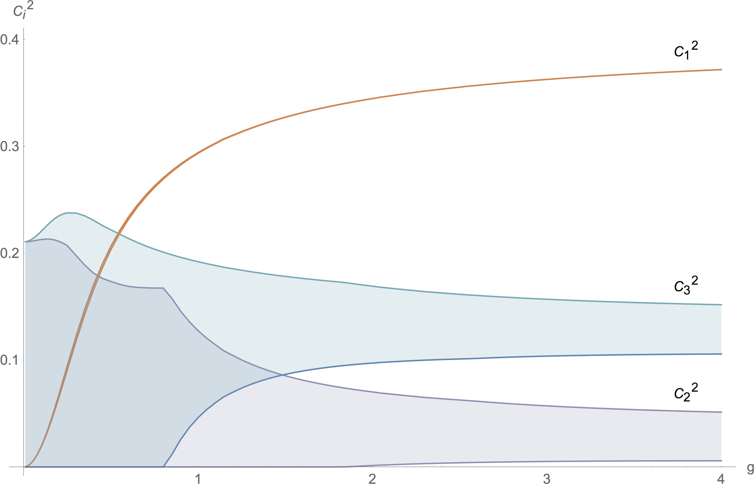
First 3 OPE coefficients including the first 10 states
[Cavaglià, Gromov, Julius, MP ’22]
$$N_{der}=60$$
The error reduces from 16% to 75% depending on the coupling

Slide 25
Can we do better?

Slide 26
Integrated correlators

Slide 27
Line deformations
Defect breaks translation invariance
Displacement
Operator
$$εℬ_{1}$$
$$∂_{μ}T^{μi}(x)=δ(x_{⊥})D^{i}(x_{||})$$
$$δW$$
Correlation function of arbitrary operator in presence of the line deformation
$$⟨X⟩_{W+δW}=∫dt⟨⟨XD_{i}(t)⟩⟩δx^{i}(t)+𝒪(δx^{2})$$
The first non-trivial correlator is
$$⟨⟨D_{m}D_{n}⟩⟩=C_{D}\frac{δ_{m,n}}{t^{4}}$$
Fixed by conformal
symmetry

Slide 28
Line deformations
Defect breaks translation invariance
Displacement
Operator
$$εℬ_{1}$$
$$∂_{μ}T^{μi}(x)=δ(x_{⊥})D^{i}(x_{||})$$
Expectation value is divergent and contains the cusp anomaly
$$⟨W_{cusp}⟩=e^{−Γ_{cusp}log\frac{L}{ε}}$$
In the near BPS limit ($φ→0$), it is controlled by the displacement operator
$$Γ_{cusp}∼−\frac{1}{2}φ^{2}∫dt⟨⟨D(t)D(0)⟩⟩=−\frac{C_{D}}{12}φ^{2}$$

Slide 29
Line deformations
$$δW$$
$$⟨⟨D_{m}D_{n}⟩⟩=C_{D}\frac{δ_{m,n}}{t^{4}}$$
$$Γ_{cusp}∼−\frac{1}{2}φ^{2}∫dt⟨⟨D(t)D(0)⟩⟩=−\frac{C_{D}}{12}φ^{2}$$
The cusp anomalous dimension at order $φ^{2}$ is computed exactly
$$Γ_{cusp}∼−𝔹φ^{2}$$
$$𝔹=\frac{1}{2π^{2}}λ∂_{λ}log⟨W_{circle}⟩$$
Bremsstrahlung
function
[Correa, Henn, Maldacena, Sever ’12]
$$C_{D}=12𝔹$$
$$∫dt⟨⟨D(t)D(0)⟩⟩=2𝔹$$

Slide 30
Line deformations
$$δn$$
$$⟨⟨Φ_{⊥}^{i}Φ_{⊥}^{j}⟩⟩=C_{Φ}\frac{δ_{i,j}}{t^{2}}$$
$$Γ_{cusp}∼\frac{\sin^{2}θ}{2}∫dt⟨⟨Φ_{⊥}(t)Φ_{⊥}(0)⟩⟩=−\frac{C_{Φ}}{2}\sin^{2}θ$$
The cusp anomalous dimension at order $\sin^{2}θ$ is computed exactly
$$Γ_{cusp}∼𝔹\sin^{2}θ$$
$$𝔹=\frac{1}{2π^{2}}λ∂_{λ}log⟨W_{circle}⟩$$
Bremsstrahlung
function
[Correa, Henn, Maldacena, Sever ’12]
$$C_{Φ}=2𝔹$$
$$∫dt⟨⟨Φ_{⊥}(t)Φ_{⊥}(0)⟩⟩=−2𝔹$$
Can we exploit the line deformations to obtain constraints for our four-point function?

Slide 31
New integrated correlators
We can follow the same logic but expanding the cusp anomaly to the next order
$$Γ_{cusp}=𝔹\sin^{2}θ+\frac{1}{4}(𝔹+ℂ)\sin^{4}θ+𝒪(\sin^{6}θ)$$
[Gromov,Levkovich-Maslyuk’15]
Curvature
function
$$ℂ(g)=−4𝔹^{2}−\frac{1}{2}∮\frac{du_{x}}{2πi}∮\frac{du_{y}}{2πi}S[u_{x},u_{y}]$$
Solving the integrals running clockwise around the cut $[−2g,2g]$, we obtain
[Cavaglià, Gromov, Julius, MP ’22]
$$ℂ=4g^{4}−\left(24ζ_{3}+\frac{16π^{2}}{3}\right)g^{6}+\left(\frac{64π^{2}ζ_{3}}{3}+360ζ_{5}+\frac{64π^{4}}{9}\right)g^{8}−\left(\frac{112π^{4}ζ_{3}}{5}+272π^{2}ζ_{5}+4816ζ_{7}+\frac{416π^{6}}{45}\right)g^{10}$$
$$+\left(\frac{3488π^{6}ζ_{3}}{135}+\frac{2192π^{4}ζ_{5}}{9}+\frac{9184π^{2}ζ_{7}}{3}+63504ζ_{9}+\frac{176π^{8}}{15}\right)g^{12}+O\left(g^{14}\right)$$
$$ℂ=\frac{\left(2π^{2}−3\right)g}{6π^{3}}+\frac{−24ζ_{3}+5−4π^{2}}{32π^{4}}+\frac{11+2π^{2}}{256π^{5}g}+\frac{96ζ_{3}+75+8π^{2}}{4096π^{6}g^{2}}+\frac{3\left(408ζ_{3}−240ζ_{5}+213+14π^{2}\right)}{65536π^{7}g^{3}}+\frac{3\left(315ζ_{3}−240ζ_{5}+149+6π^{2}\right)}{65536π^{8}g^{4}}+O\left(\frac{1}{g^{5}}\right)$$

Slide 32
New integrated correlators
[Cavaglià, Gromov, Julius, MP ’22]
The four-point function $𝒜$ and the reduced correlator $f$ obey the following constraints
Constraint 1
Constraint 2
$$∫_{0}^{1}δ𝒜(χ)\frac{1+logχ}{χ^{2}}dχ=\frac{3ℂ−𝔹}{8𝔹^{2}}$$
$$∫_{0}^{1}\frac{δf(χ)}{χ}dχ=\frac{ℂ}{4𝔹^{2}}+𝔽−3$$
$$δ𝒜(χ)≡𝒜(χ)−𝒜_{weak}^{(0)}(χ),δf(χ)≡f(χ)−f_{weak}^{(0)}(χ)$$
Where and the zero-coupling values are
$$f_{weak}^{(0)}(χ)=2χ+\frac{χ}{χ−1},𝒜_{weak}^{(0)}(χ)=\frac{2(χ−1)χ+1}{(χ−1)^{2}}$$
We tested both at weak and strong coupling.
Recently a linear combination of them has been proven
A complete proof of both constraints is in preparation
[Drukker, Kong, Sakkas ’22]
[Cavaglià, Gromov, Julius, MP to appear]
Huge impact on the Bootstrability output

Slide 33
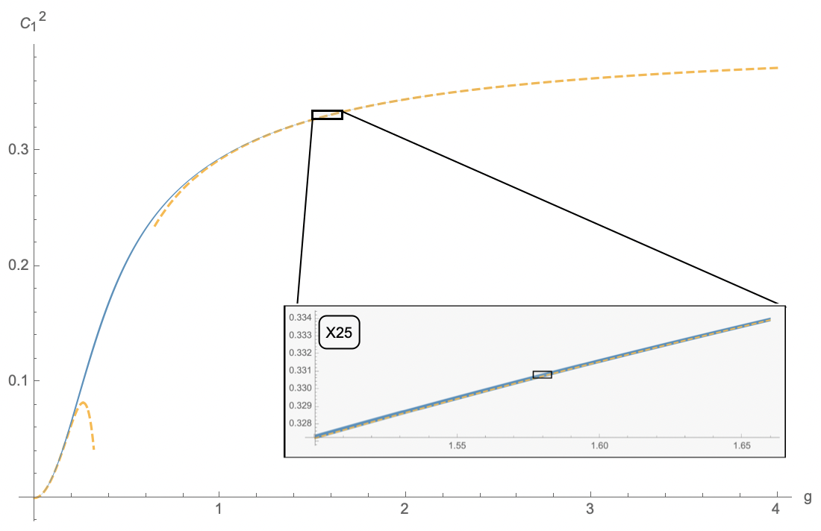
Super tight bounds for structure constant
2 states from QSC
A.Cavaglià, NG, J.Julius, M.Preti, N.Sokolova `21

Slide 34
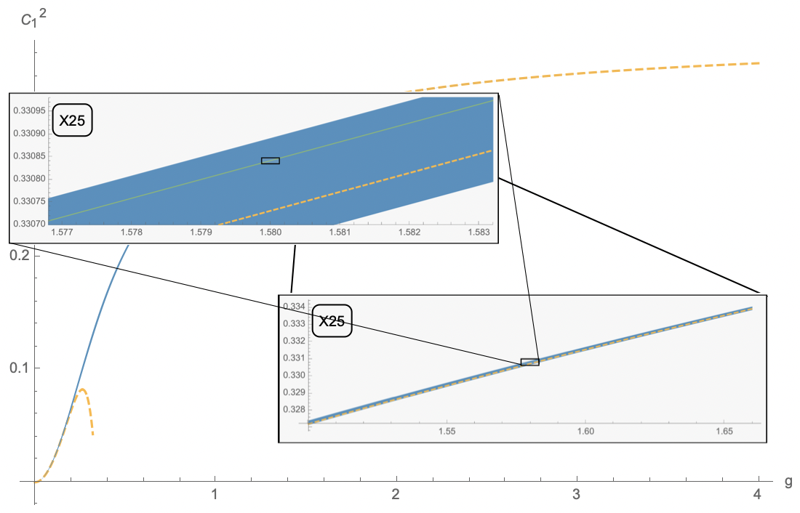
Super tight bounds for structure constant
10 states, +curvature function
A.Cavaglià, NG, J.Julius, M.Preti, N.Sokolova `22

Slide 35
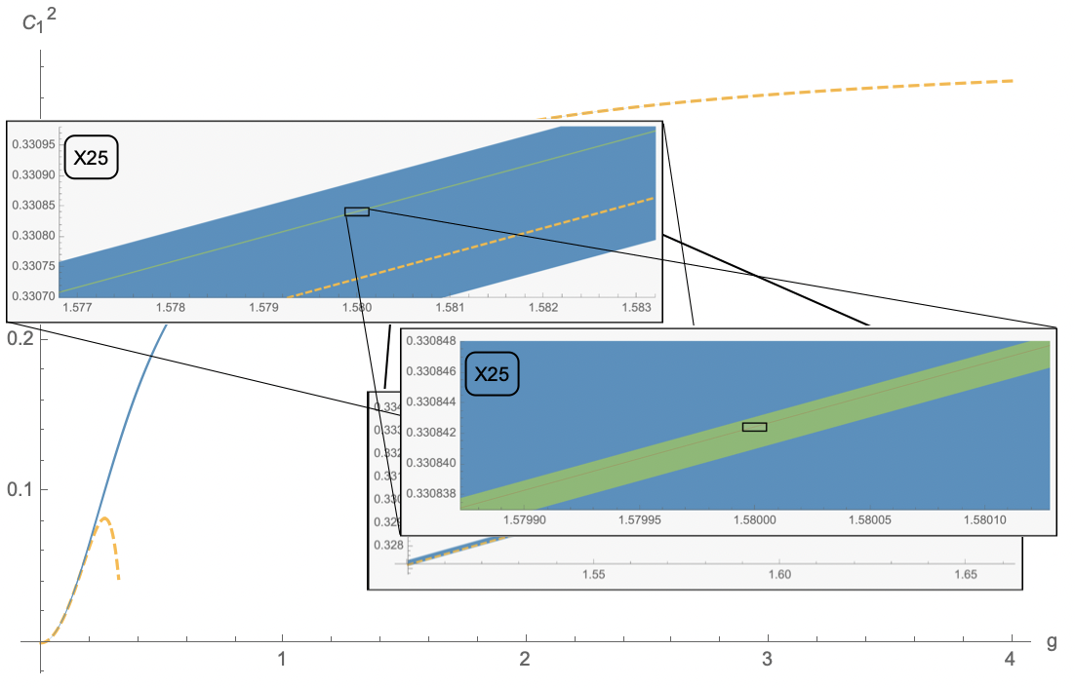
Super tight bounds for structure constant
10 states, +curvature function
A.Cavaglià, NG, J.Julius, M.Preti, N.Sokolova `22

Slide 36
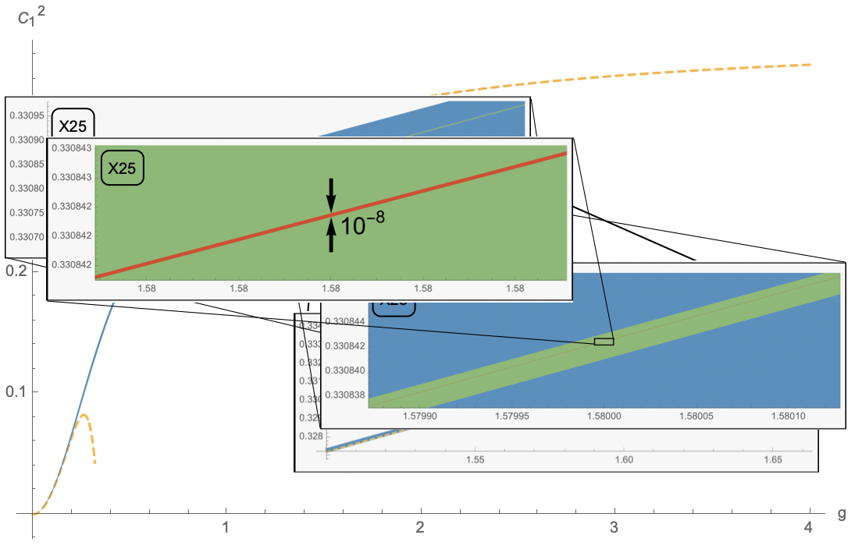
Super tight bounds for structure constant
No other methods
available!
Only spectrum goes in, no extra localization data, this includes spectrum of deformed theory, which gives integrated correlators

Slide 37
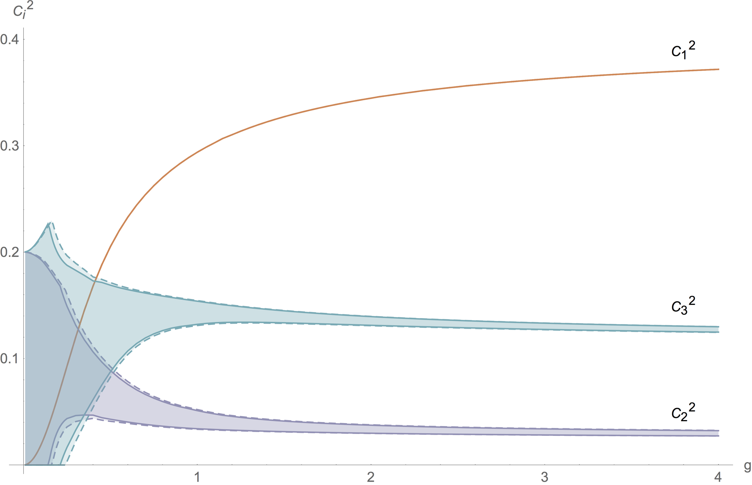
[Cavaglià, Gromov, Julius, MP ’22]
$$N_{der}=60$$
Constraint 2
Constraint 1

Slide 38
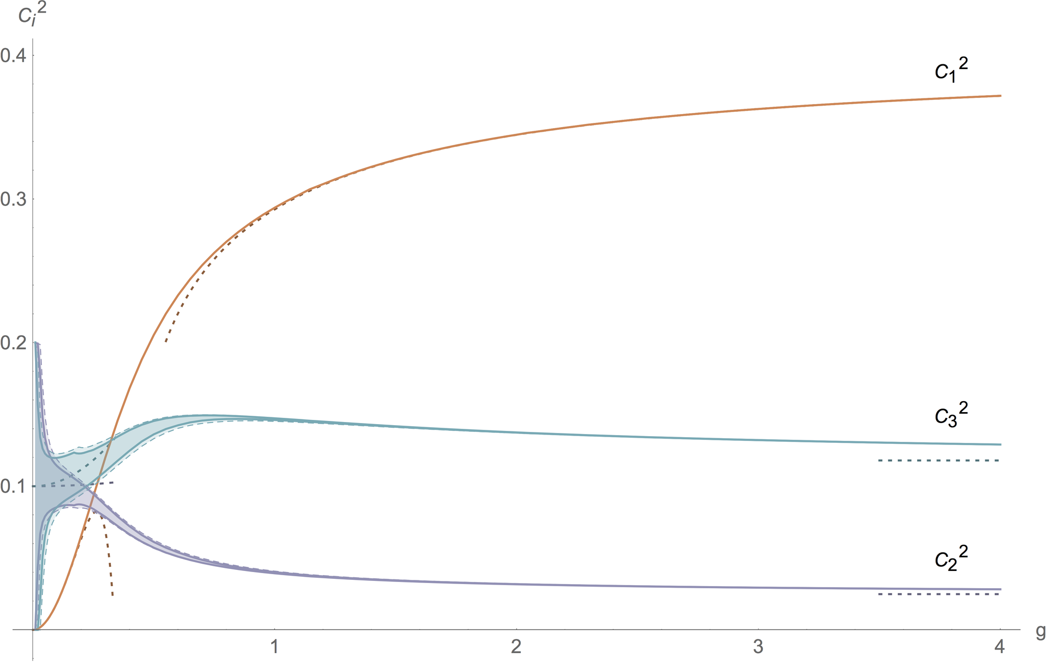
[Cavaglià, Gromov, Julius, MP ’22]
$$N_{der}=60\text{and} 140$$
$$𝒪(1/g^{4})$$
$$𝒪(g^{2})$$
$$𝒪(1/g^{0})$$
$$𝒪(g^{8})$$

Slide 39
Analytic Bootstrability

Slide 40
Strategy at weak coupling
The four-point function at weak coupling is known only up to order $g^{2}$
[Kiryu Komatsu’18]
Our strategy to compute higher orders is to formulate an ansatz in terms of Harmonic Polylogarithms (HPL) and then fix the coefficients using
Crossing equation
Logarithms cancellation
Conformal data matching
Integral relations
Uniform transcendentally
At order $g^{4}$ we obtain
[Cavaglià, Gromov, Julius, MP ’22]
$$G_{weak}^{(2)}(x)=\frac{4(1−2x)}{(1−x)^{2}}[\frac{π^{2}}{3}(H_{2}−H_{1,0}+H_{1,1})−3ζ_{3}H_{1}+2(H_{1,2,1}−H_{1,1,2}−H_{2,0,0}−H_{1,1,0,0})$$
$$+\frac{(x−1)x+1}{2x−1}\left(2H_{2,1}−2H_{1,0,0}+(x−1)H_{1,1,0}−(x−2)H_{2,0}+xH_{3}+\frac{π^{2}}{3}(H_{1}−xH_{0})\right)$$
$$+\frac{(x^{3}+1)}{1−2x}H_{1,2}+H_{1,3}−H_{2,2}+2H_{3,0}+2H_{3,1}+H_{1,2,0}−H_{2,1,0}+x\frac{2π^{4}x−45((x−1)x+1)ζ_{3}}{15(2x−1)}]$$

Slide 41
OPE coefficients at weak coupling
As a bi-product we obtain several results for the structure constants of which the most interesting ones are the following
Classical dimension = 1
$$C_{1}^{2}(g)=2g^{2}−\left(24−\frac{4π^{2}}{3}\right)g^{4}+\left(320−16π^{2}+48ζ_{3}−\frac{76π^{4}}{45}\right)g^{6}$$
$$−\left(4480−\frac{832π^{2}}{3}+256ζ_{3}−\frac{224π^{4}}{15}+880ζ_{5}−\frac{64π^{6}}{45}\right)g^{8}+O(g^{10})$$
Classical dimension = 2
$$C_{2}^{2}=\frac{1}{10}+\frac{1}{150}\left(10π^{2}−75−9\sqrt{5}\right)g^{2}+O(g^{4})$$
$$C_{3}^{2}=\frac{1}{10}+\frac{1}{150}\left(10π^{2}−75+9\sqrt{5}\right)g^{2}+O(g^{4})$$
Classical dimension = 3
$$C_{6}^{2}=\frac{1}{14}+\frac{2}{7\sqrt{37}}+O(g^{2})C_{8}^{2}=\frac{1}{14}−\frac{2}{7\sqrt{37}}+O(g^{2})$$
[Cavaglià, Gromov, Julius, MP ’22]

Slide 42
What’s next?
Have not even tried multi-correlators yet! With ~10 states, there are a lot of correlators!
Local operators - we gain a lot more symmetry (4D CFT) with a similar (smaller?) number of states.
We can also add data from deformations of N=4 (QSC known)
Get rid of SUSY and Unitarity – with known spectrum those are not crucial – could help to simplify the standard numerical bootstrap

Slide 43
Should we care about anything else?
Separation of Variables for correlation functions? (see talk of Paul)
One-point functions as determinants? (see talk of Joao)
Form-factor program (hexagon/octagon amplitudes)? (see talk of Alessandro)

Slide 44
Bootstrap more crazy correlators?

